Slide 1
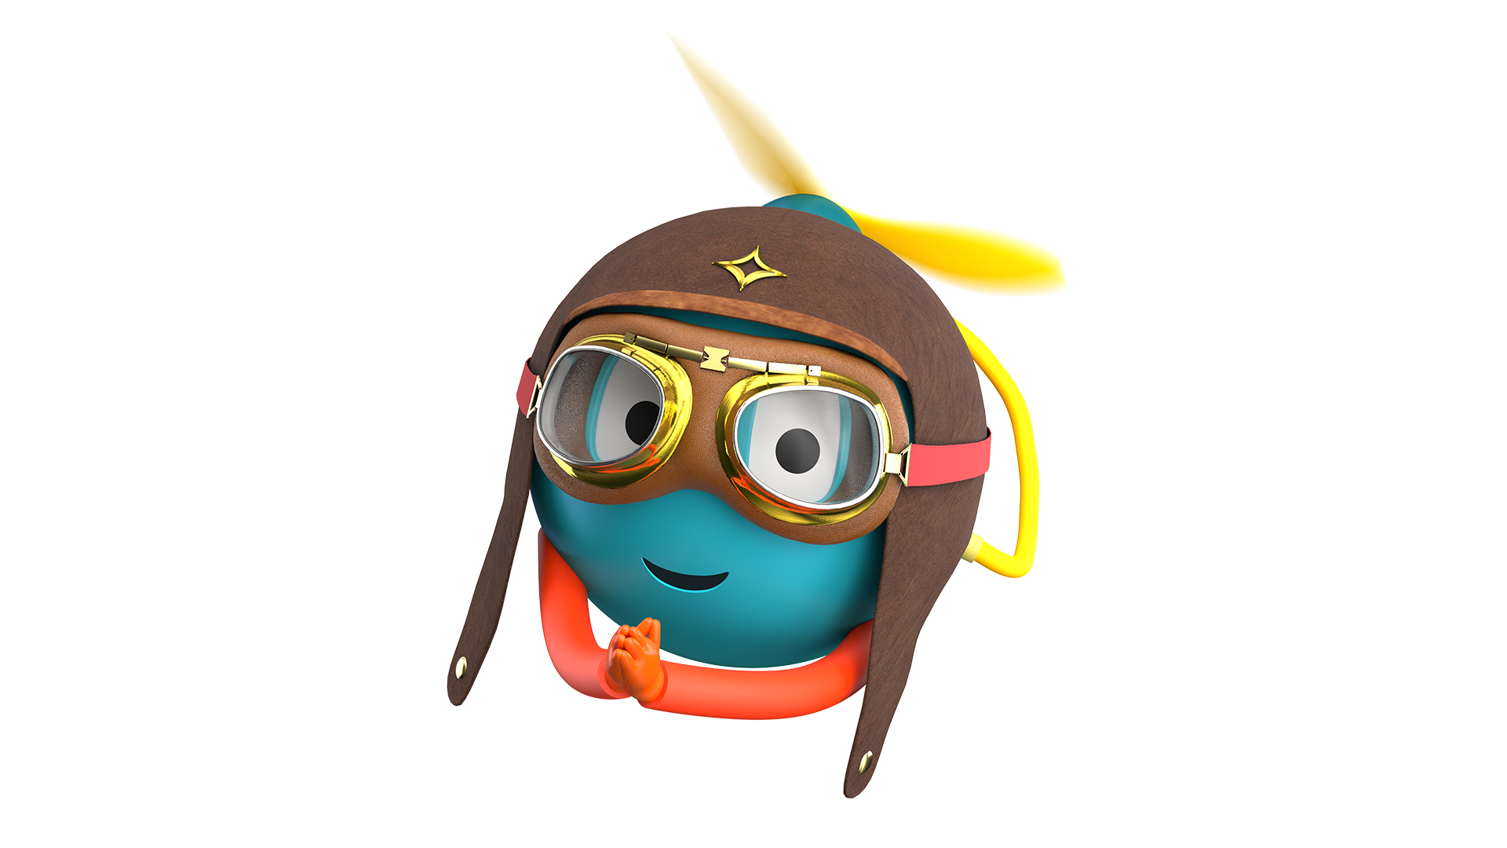
AURA- Adaptive Universal
Reality ASSISTANT
A multimodal AI accessibility platform that combines computer vision, conversational AI, document intelligence, and intelligent automation to simplify everyday life for people with disabilities.

Slide 2
Problem statement and proposed solution
Problem
Solution
AURA is an AI-powered accessibility companion that combines multimodal AI with UiPath intelligent automation to help people with disabilities navigate, understand, and automate everyday tasks . It is more than a typical AI assistant it’s like an intelligent accessibility companion that helps users move around, make sense of information, and finish daily activities with more confidence. and, honestly, more independence too.
People with disabilities often deal with unnecessary barriers when they’re using digital services, government portals, and regular everyday places. While a lot of accessibility tools solve one little thing at a time, very few actually give a unified experience, one that can “read” what the person is seeing around them, explain complicated stuff, and also automate tasks in the real world.

Slide 3
Benefits and technologies used
Benefits, impact and outcomes
End-user​ | People with disabilities,Senior citizens,Government service applicants
User department​ | Government Citizen Service Centers,Disability Support Organizations,NGOs
Industries​ | Accessibility,Public Services,Government,Healthcare
UiPath products used​ | UiPath Studio - UiPath Agent Builder - UiPath Maestro
Other - integrations / APIs / technologies used​ | React - TypeScript - Vite - Tailwind CSS - Node.js - Express.js
Reduces the complexity of government paperwork through AI-guided assistance.
Enables users to understand official documents using AI-powered document intelligence.
Minimizes repetitive form filling with reusable user profiles and automation.
Improves accessibility by combining voice, vision, and document understanding in a single platform. .

Slide 4
Solution architecture
"See complete architecture and screenshots in our GitHub repository:"
GitHub Repo: https://github.com/nisithaa-03/AURA-.git

